Slide 1
Metallic Bonding

Slide 2
Metallic Bonds Properties
Bond Formation | e⁻ are delocalized among metal atoms
Occurs Between | 2 Metals
Type of Structure | “Electron Sea”
Physical State | Solid
Melting Point | Very High
Soluble in Water | No
Electrical Conductivity | Yes
Other Properties | Malleable, Ductile, Lustrous

Slide 3
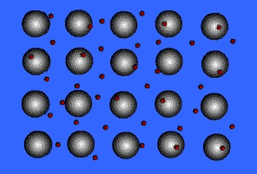
Type of Structure
“Electron Sea”

Slide 4
Conduction of Heat
Electrons are able to gain kinetic energy in hotter areas of the metal and are able to quickly transfer it to other parts of the metal lattice because of their freedom of movement. Heat causes the electrons to move faster and the ‘bumping’ of these electrons with each other and the protons transfers the heat.

Slide 5
Conducts Electricity
When an electric field is applied to a metal, one end of the metal becomes positive and the other becomes negative. Since the electrons are free to move, all the electrons experience a force toward the positive end. The movement of electrons is an electric current.

Slide 6
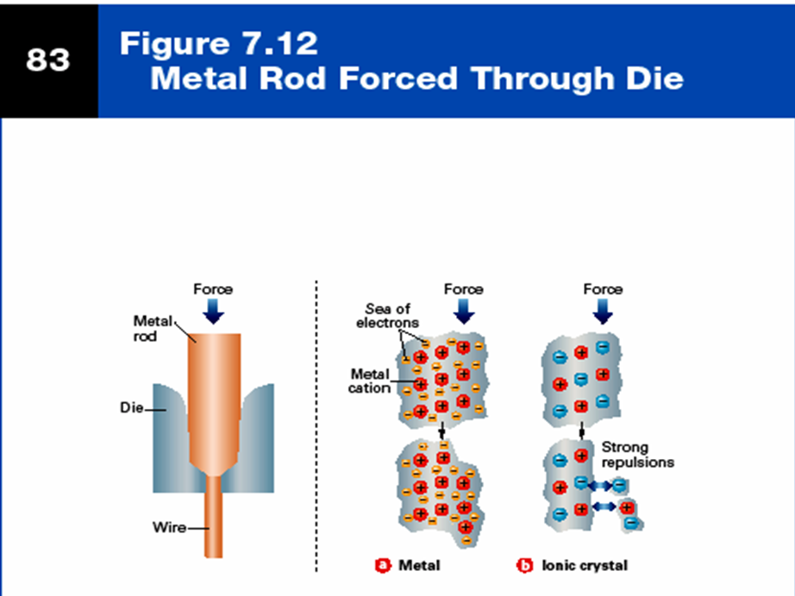
Malleable and Ductile

Slide 7
Malleable and Ductile
Metals are malleable and ductile, rather than brittle, as a result of the non-directional nature of metallic bonds. The attractive forces exerted by the positive metal ions for the mobile electrons occur in all directions. This means that layers of atoms can move past one another without disrupting the force between the positive ions and the negative sea of electrons.

Slide 8
Malleable and Ductile
+
+
+
+
Force
+
+
+
+
+
+
+
+

Slide 9
Malleable and Ductile
Mobile e-’s allow atoms to slide by
like ball bearings in oil.
+
+
+
+
Force
+
+
+
+
+
+
+
+

Slide 10
High Melting Point
The generally high melting points indicate that metallic bonding is quite strong.
Melting points increase with an increase in the number of valence electrons to the sea, since there is a greater attractive force between the cations and the electrons.

Slide 11
High Density
Most metals have relatively high densities because metallic lattices are close-packed.

Slide 12
Structure of Metals
Electrostatic forces of attraction between the positively charged cations and the negatively charged electrons hold the lattice together.
A metal is therefore a seen as a rigid framework of cations immersed in a ‘sea’ of electrons that serve as the cement holding the three-dimensional cationic network together – Metallic bonding.

